Slide 1
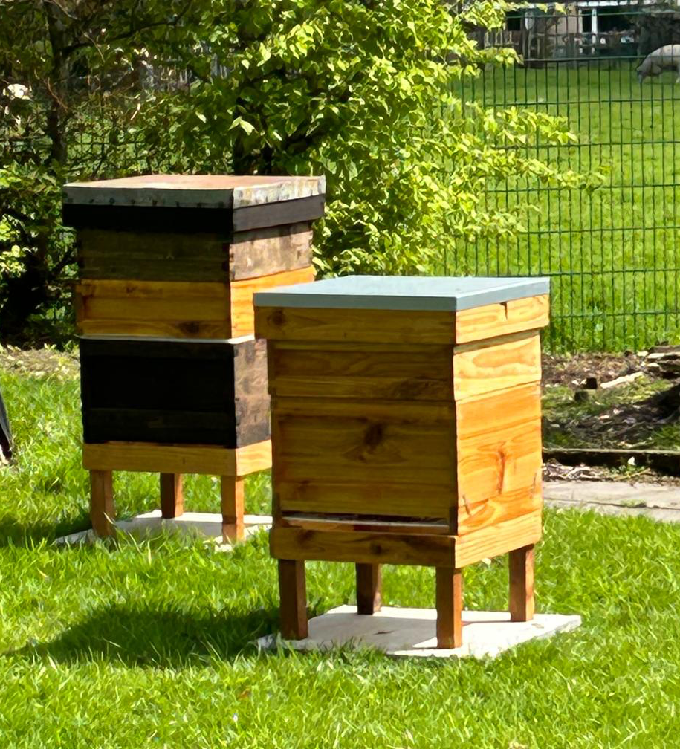
Adult Beekeeping Experience
Discover the captivating world of honeybees with an exclusive outdoor 2hr 30min beekeeping experience.
The session will include an introduction to honeybees and the inner workings of the colony.
This is then followed by an outdoor session exploring an actual honeybee hive and delving into the workings of an actual thriving honeybee colony under the supervision of two expert beekeepers whilst being suited in a bee suit.
This hands-on experience promises to deepen your appreciation for these vital-pollinators and their crucial role in our ecosystem.
The session is £40 per person. Book now by calling 01254 822338
Set in the heart of Clitheroe at Barrow Primary School.

Slide 2

Children’s Beekeeping Experience
A 1-hour beekeeping session designed especially for young children delivered by two expert beekeepers. This hands-on experience offers young students a unique opportunity to suit up in a beekeeping suit, explore a real beehive with a full working colony in a safe and enjoyable way.
Through exploring the amazing inner workings of a honeybee colony children will learn many fascinating facts about bees, their lives, beekeeping and most importantly their essential role in the ecosystem.
With expert guidance throughout the entirety of the experience and plenty of fun, your child will leave buzzing with excitement and newfound knowledge.
The price per child is £15. Book now by calling 01254 822388
Set in the heart of Clitheroe at Barrow Primary School.

