Slide 1


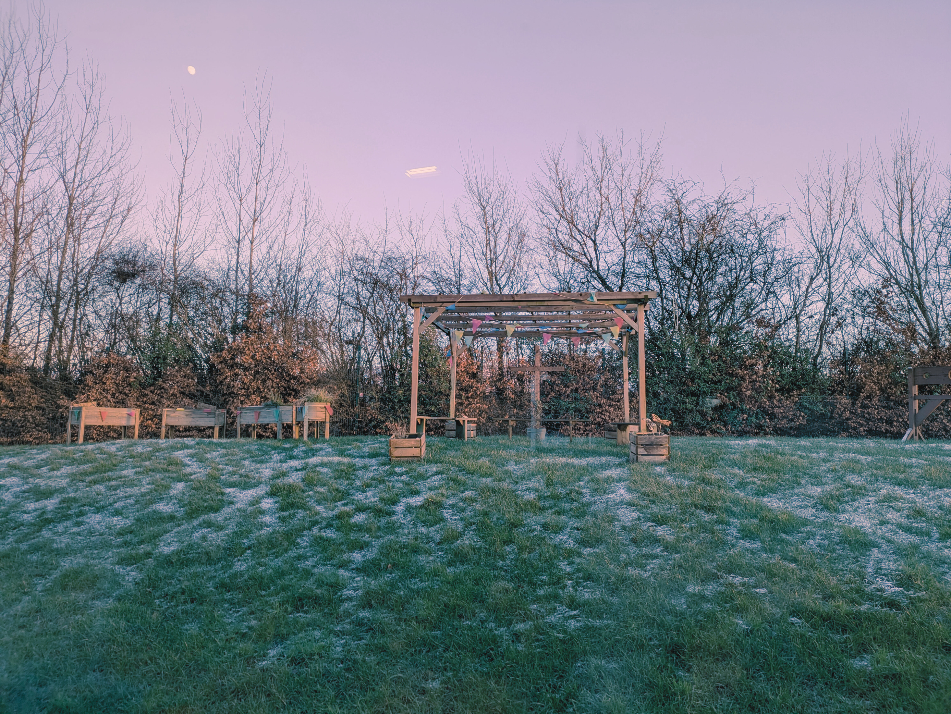


Year 3
Sycamore Class
Meet the
Teacher

Slide 2

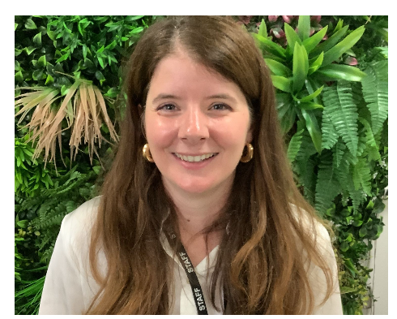
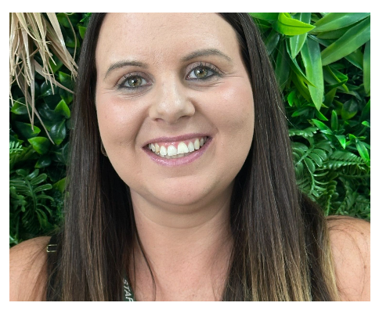
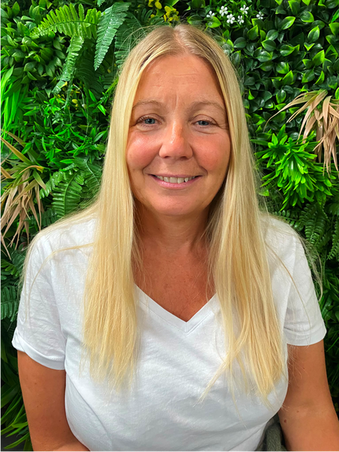
Staff
Mrs Rosinski
Monday-Thursday
Ms Holdsworth
Monday-Friday
Mrs Blackburn
Friday

Slide 3
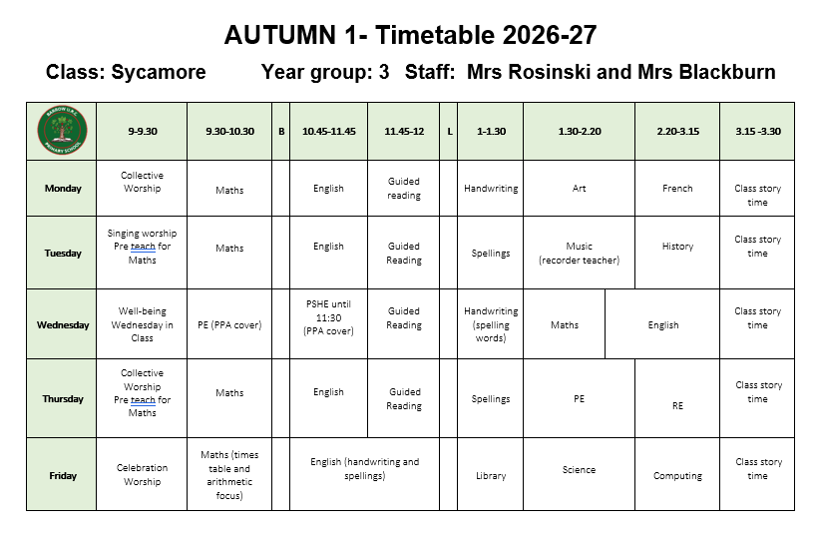
Timetable

Slide 4


PE days
Wednesday and Thursday

Slide 5
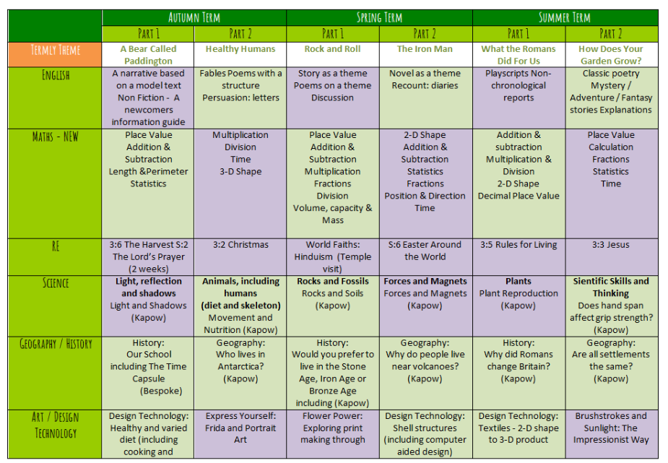
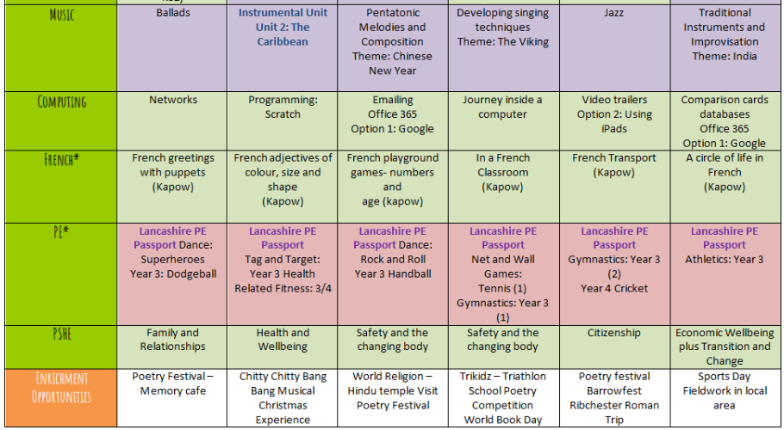
This year...

Slide 6




How you can help at home
Notes:
Look at LBQ help video for independent study

Slide 7
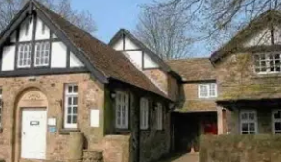



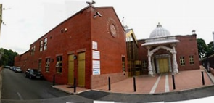
Enrichment

Slide 8
Communication – We’re Here to Help
If you have a worry, question, or simply need to talk, please don’t hesitate to get in touch.
  Catch me at the door – I’m available for a quick chat at the end of the day.
  Call or Email – You can contact the school office:
📞 Phone: 01254 882338
📧 Email: office@barrow.lancs.sch.uk
The office will forward any messages to me promptly.
We believe communication between home and school is key – no concern is too small.

